Slide 1
eQuotation System
Bidder interface

Slide 2
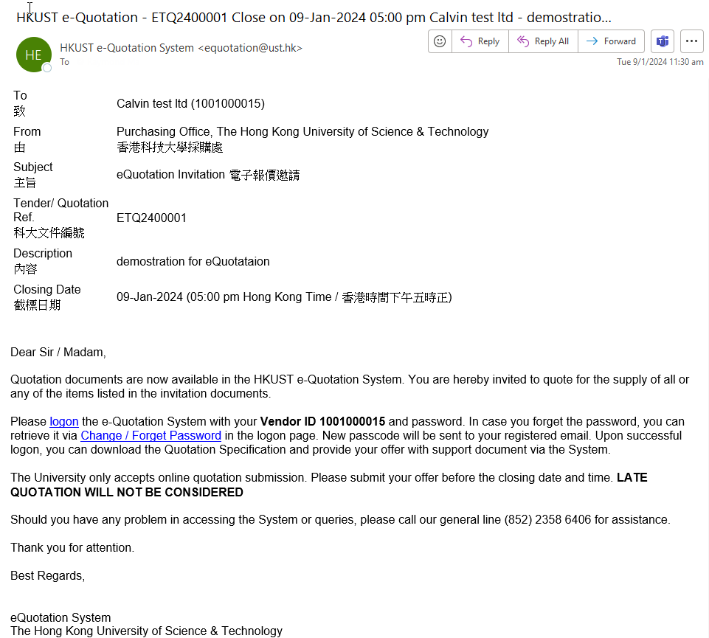
Submit Quotation
Step 1 – Receive Invitation of eQuotation
Note
For existing vendor, Click “Logon” to start the quotation submission (go to step 2a)
For new vendor, or existing vendor who forget your logon password. Click “Change / Forget Password” (go to step 2b)
1
2

Slide 3
Submit Quotation
Step 2a – Logon and download the quotation specification
Note
Read the T&C and check the box
Click “Accept” button
. . .
1
2

Slide 4
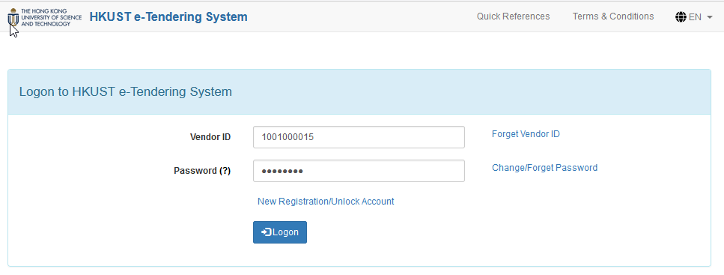
Submit Quotation
Step 2a – Logon and download the quotation specification
Note
Input Vendor ID and Password
Check “Logon” button
Then
3. Click “Quotation Request List” located in the header of the page
1
2
3

Slide 5
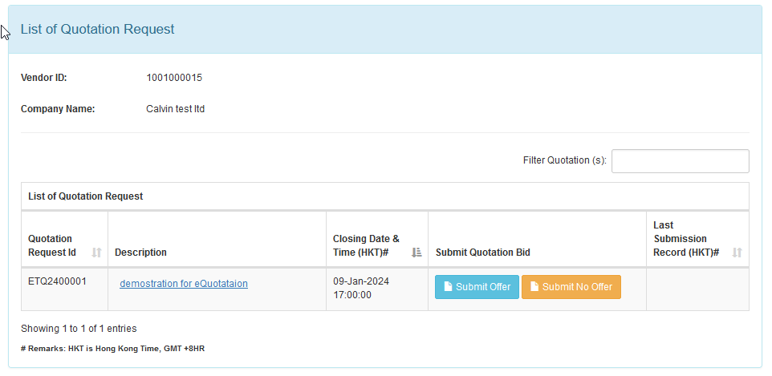
Submit Quotation
Step 2a – Logon and download the quotation specification
Note
In the List of Quotation Request page, click the Description of the Quotation request that you are interested in.
1

Slide 6
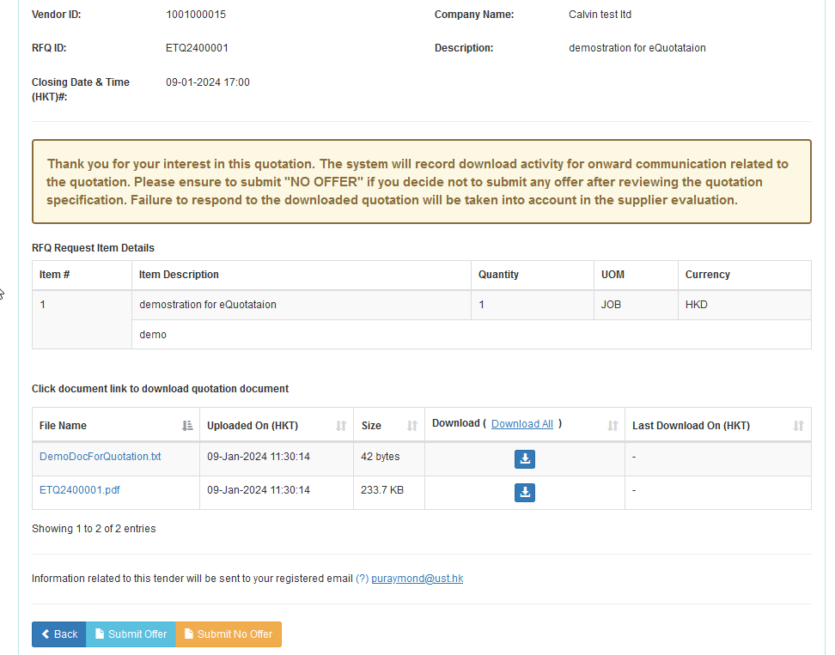
Submit Quotation
Step 2a – Logon and download the quotation specification
Note
Click “Download All” to download the quotation specification
Then, Click “Submit Offer” button to process the submission
If you are not interest to submit offer, please click “Submit No Offer”
1
2
3

Slide 7
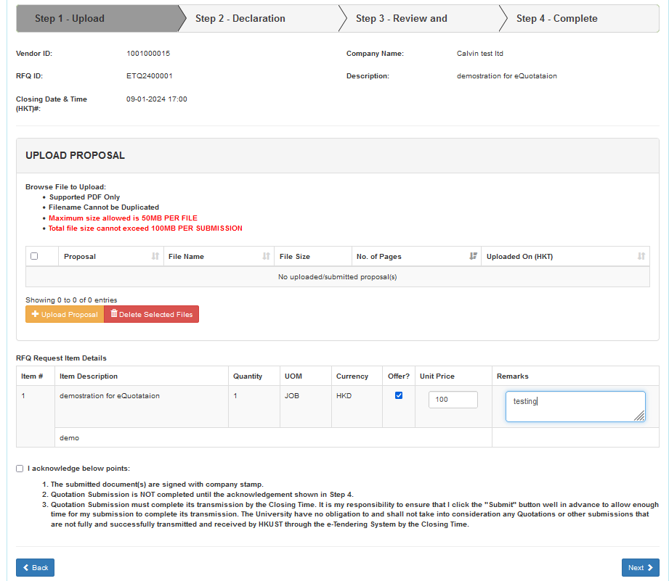
Submit Quotation
Step 3 – Provide Quotation and attach supporting documents (if have)
Note
You can attach supporting document in pdf form (if have), if not, you can leave it blank.
Check the “Offer?” box and input the Unit price. You can provide remark/description here (if have)
Read the Terms and check the box next to “I acknowledge below points”
Click “Next” for the next submission step
1
2
3
4

Slide 8
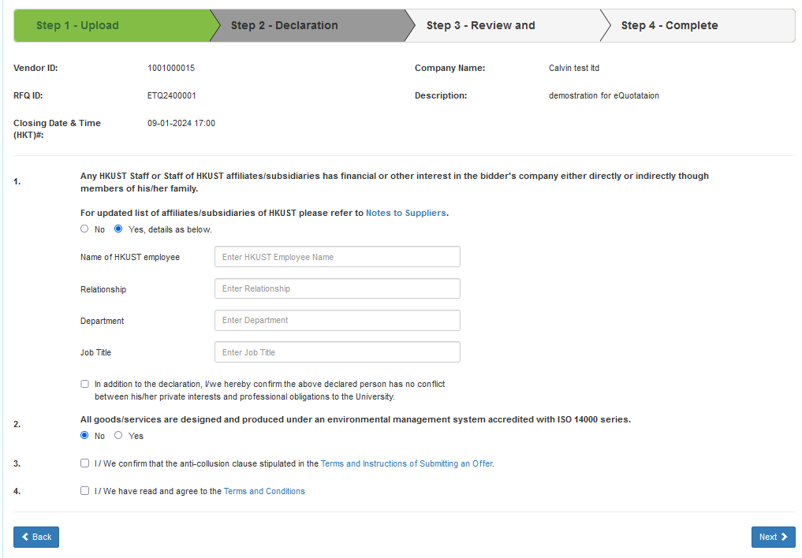
Submit Quotation
Step 4 – Declaration
Note
Do the declaration for your submission
If have financial or other interest with the University or University’s affiliates, you should select “Yes” and fill all the details provided on the screen.
Check the rest of the boxes and radio button after reading our Terms and Instructions of Submitting an Offer and General Terms and Conditions.
Click “Next” for the next submission step
1
2
3

Slide 9
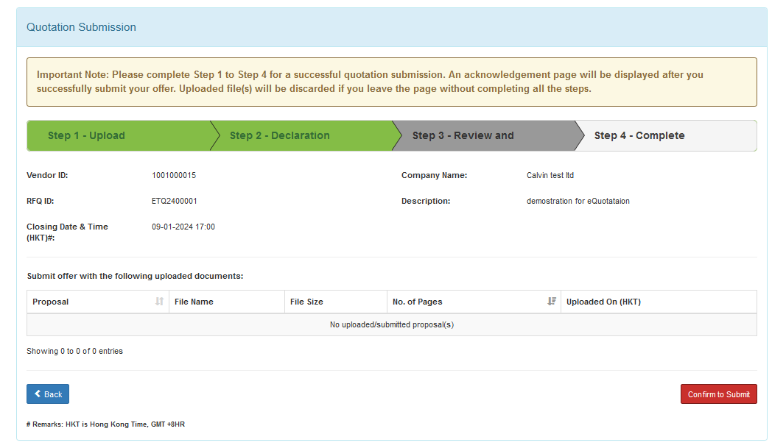
Submit Quotation
Step 4 – Confirmation
Note
1. Click “Confirm to Submit” to complete the submission.
1

Slide 10
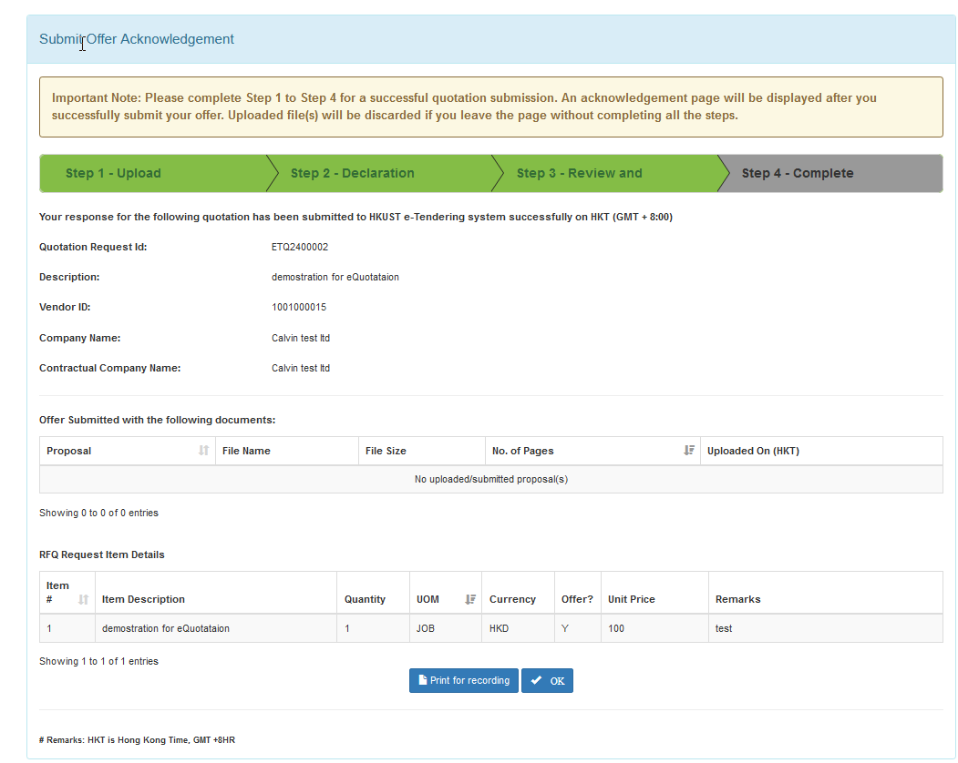
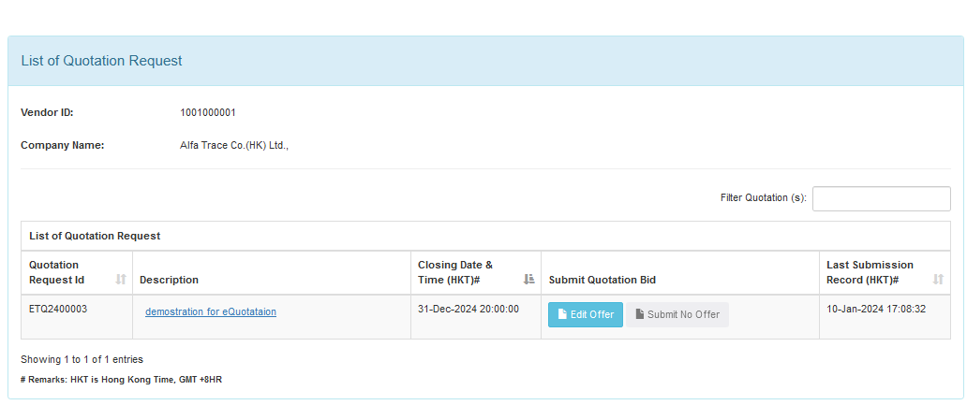
Submit Quotation
Step 4 – Submission Complete / Update Submission
Note
Click “OK” to leave the system. And you submission is completed
You can login the system again to check and update the quotation if needed. By clicking the link in the invitation email again, and navigate to List of Quotation Request Page, click “Edit Offer” button to update your submission.
1
2

Slide 11
END

Slide 12
Submit Quotation
Step 2b – Set / Reset Password
Note
Read the T&C and check the box
Click “Accept” button
. . .
1
2

Slide 13
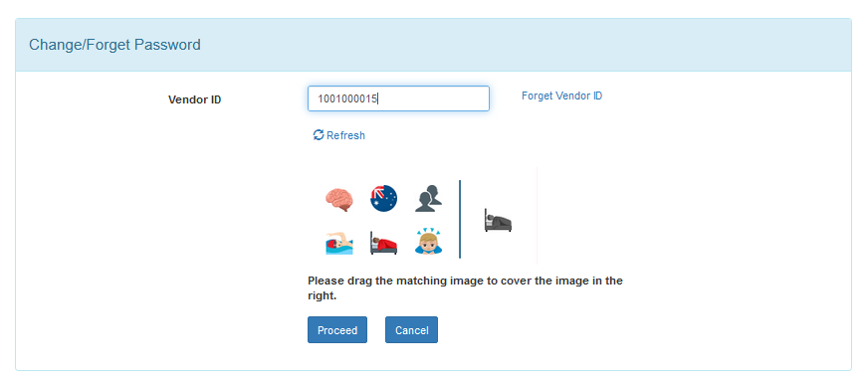
Submit Quotation
Step 2b – Set / Reset Password
Note
Input the vendor ID (normally, it has been provided by default automatically)
Drag the matching image to the cover the image in the left
Click “Process” button
Our system will sent a email to your company Primary Register Email (i.e. the email you received our eQuotation invitation)
1
2
3

Slide 14
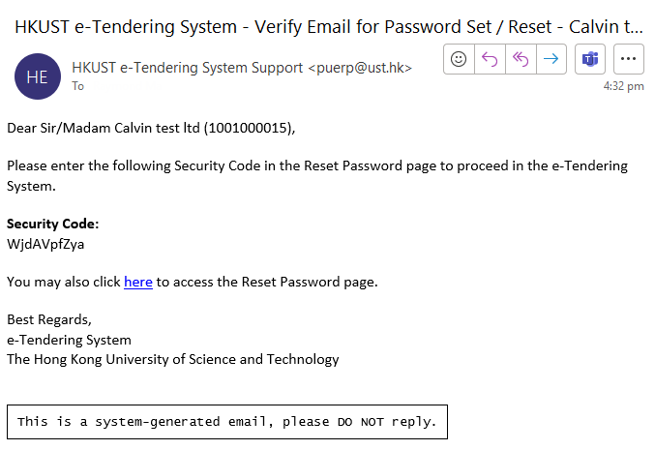
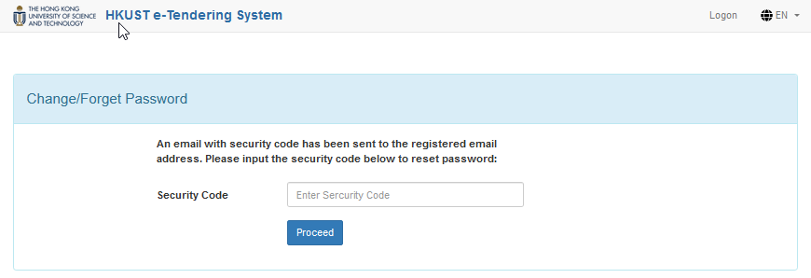
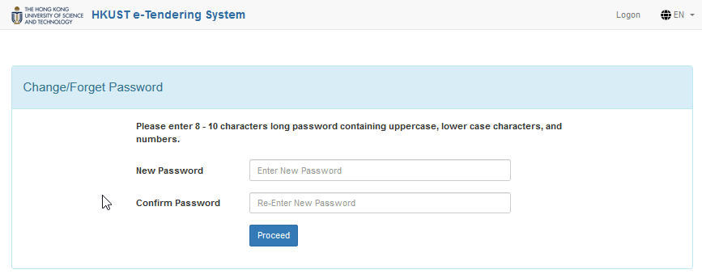
Submit Quotation
Step 2b – Set / Reset Password
Note
Click the link of the email for set/reset password
Enter the Security Code provided in the reset password email to the Change / Forget password page and press “Proceed”.
Input the new password
(Note: The password should be 8 - 10 characters long containing uppercase, lower case characters, and numbers)
2
1
3

Slide 15
Submit Quotation
Step 2b – Set / Reset Password
Note
Click the link to go to logon page
(go back to step 2a)
1

Slide 16
END

